Slide 1
Digital Portfolio
STUDENT NAME : M. Saaraha
REGISTRATION NO, NMID : 2422K2341, 8B9551960DF39E4B
DEPARTMENT : Computer Science
COLLEGE : Bharathiyar University

Slide 2
Agenda
- Problem Statement
- Project Overview
- End Users
- Tools and Technologies
- Portfolio Design & Layout
- Features & Functionality
- Results & Screenshots
- Conclusion

Slide 3
Problem Statement
Many beginners in web development lack a simple yet effective way to showcase their skills and projects. A personal portfolio website solves this by presenting their work in a professional format.

Slide 4
Project Overview
This portfolio website is built using HTML and CSS.
- Theme: Light Blue
- Sections: Home, About, Skills, Contact
- Purpose: Showcase skills and provide a way for users to connect.

Slide 5
End Users
- Students & Job Seekers
- Recruiters & Hiring Managers
- Academic Institutions
- Anyone interested in viewing personal projects

Slide 6
Tools and Technologies
- HTML5
- CSS3
- Responsive Web Design
- Text Editor: VS Code
- Browser for Testing (Chrome/Firefox)

Slide 7
Portfolio Design & Layout
- Header with Navigation Bar
- Home Section with Welcome Message
- About Section with Bio
- Skills Section with Skill Badges
- Contact Section with Form
- Footer with Copyright Info

Slide 8
Features & Functionality
- Smooth Scrolling Navigation
- Responsive Layout
- Hover Effects on Skills
- Contact Form
- Light Blue Theme for a modern look

Slide 9
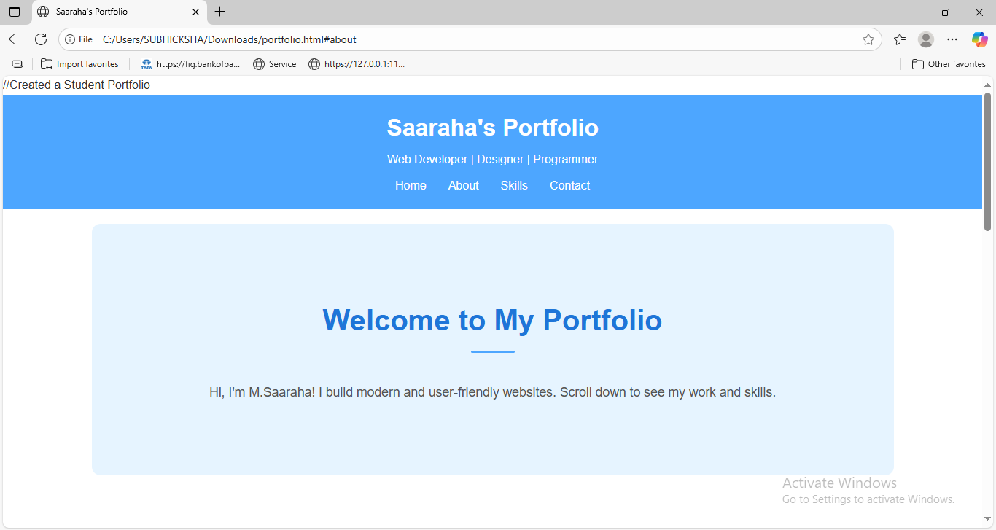
Screenshots & results
Home Section

Slide 10
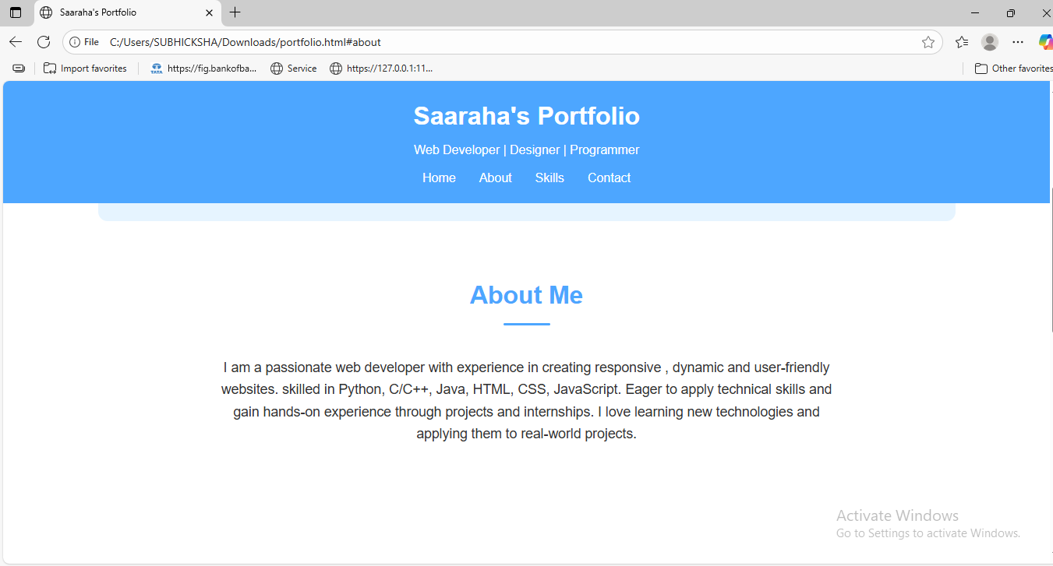
Screenshots - 2
About Section

Slide 11
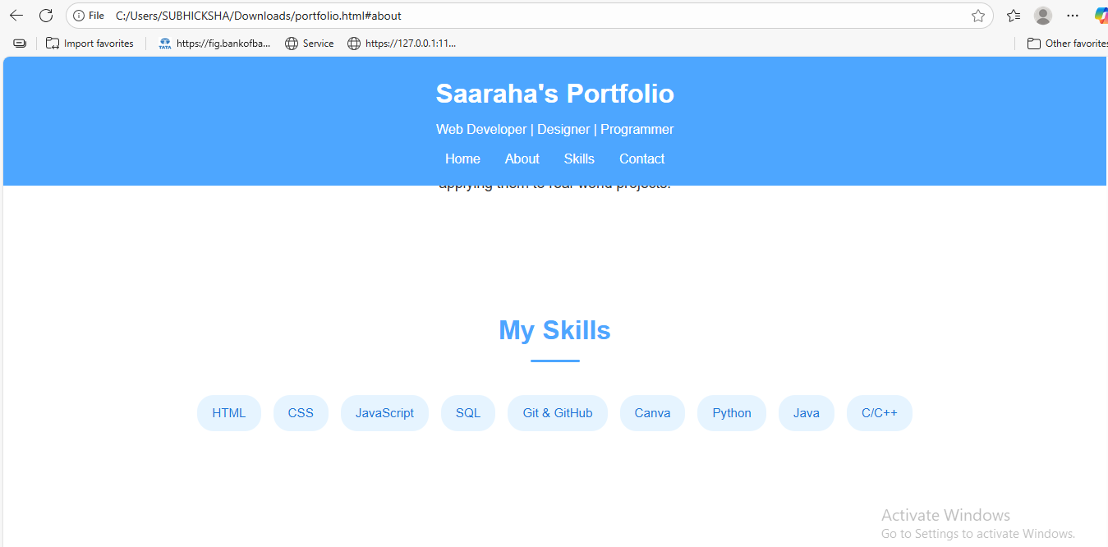
Screenshot - 3
Skills Section

Slide 12
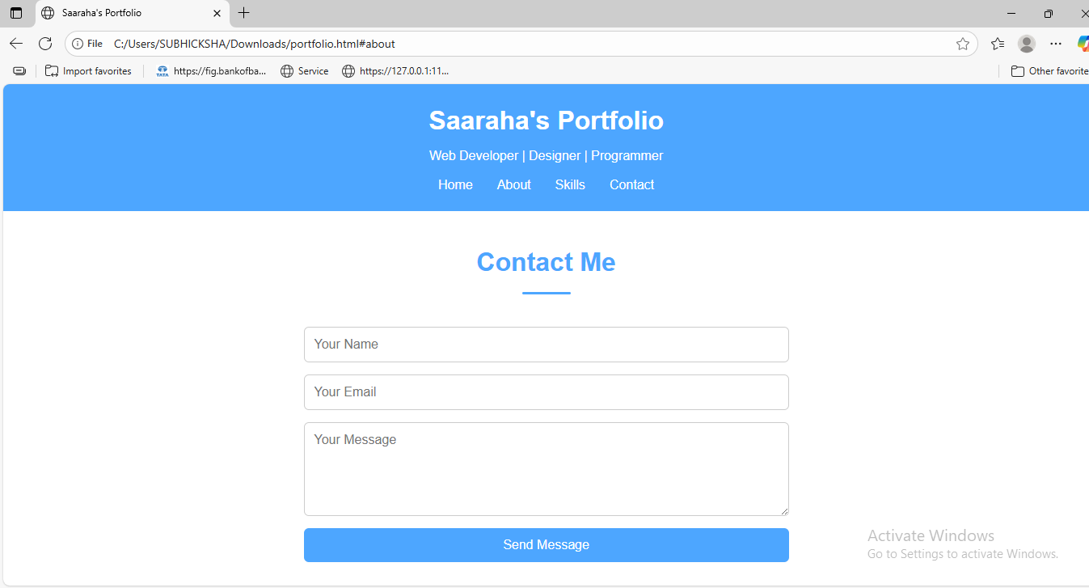
Screenshot - 4
Contact Section

Slide 13
Conclusion
The portfolio website provides a professional platform to showcase skills and connect with potential recruiters or collaborators. It is a strong foundation for building advanced projects using JavaScript, React, or backend technologies.

